Slide 1

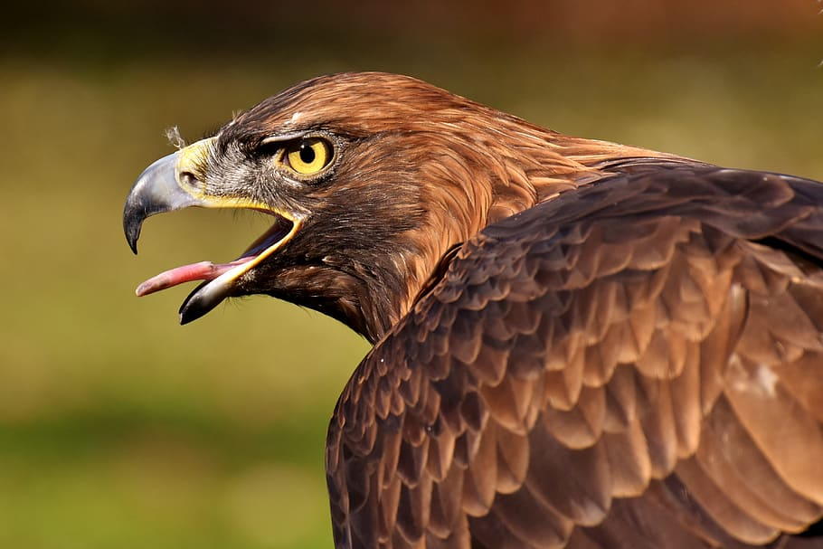
The Best Way To Take Care Of a Bird of Prey
Did you just get a Golden Eagle and don’t know how to take care of it? Well let me help you.
If you want to make sure your Golden eagle is the healthiest it can be, If you want your golden eagle to burst with happiness, If you looked on every website possible and still have no idea what to do, let me promote you to the best guaranteed way to care for your golden eagle.
Golden Eagles take around 6 years to fully mature. They live up to 60 years in captivity that is if you take care of it correctly read on to find out how. And they live up to 10-17 in the wild alternatively the highest recorded age in the wild was in fact 36. Males should way 360g and females around 510g. Weight is important due to the fact that it implies to your bird being healthy.
They are commonly found in Scotland’s upland forests and devour mammals and birds.
Native vegetation seems to attract the eye, typically avoiding developed areas from urban to agricultural as well as heavily forested regions.
You Will Need
This is a Golden Eagle
Big Enclosure; Carrion; Rabbits; Hares, Grouse, Ptarmigan, Guls and more seabirds. They drink fresh water that can also be used for bathing. Transmitter and Receiver, Hood, Glove, Travel, Container, lure, tidbits and more treats for their rewards.

Slide 2
Just then, clean your bird and its enclosure, (As mentioned birds hygiene is an immense part of good health.
Eventually, check your birds heath again, you can never be too sure if your birds is ‘perfectly’ fine. Some pointers to look out for to make sure your birds health is great: Eyes- bright and alert. Nostrils- clear and dry. Beak- strong with no overgrowth, fractures or asymmetry. Inside mouth- look clean with no noxious smell.
After, feed again, your bird should eat around 3-4 times a day if not given 250g daily.
Penultimately, check your enclosure, you don't want any vicious predators in do you?
Lastly, lock up for the night.
Method
Initially, defrost you carrion; remove intestine and other offals is fine.
Secondly, defrost your food prepared for when you birds wakes up.
Next, Check your bird (health is ok, hygiene physical exercise etc.)
Then, feed your bird. Take your frozen carrions and feed around 250g average; this should last them several days.
After that, let your bird cool down and take it for a quick fly around a course, this is required due to the fact that the birds physical exercise is a big part of your bird’s health.

Slide 3
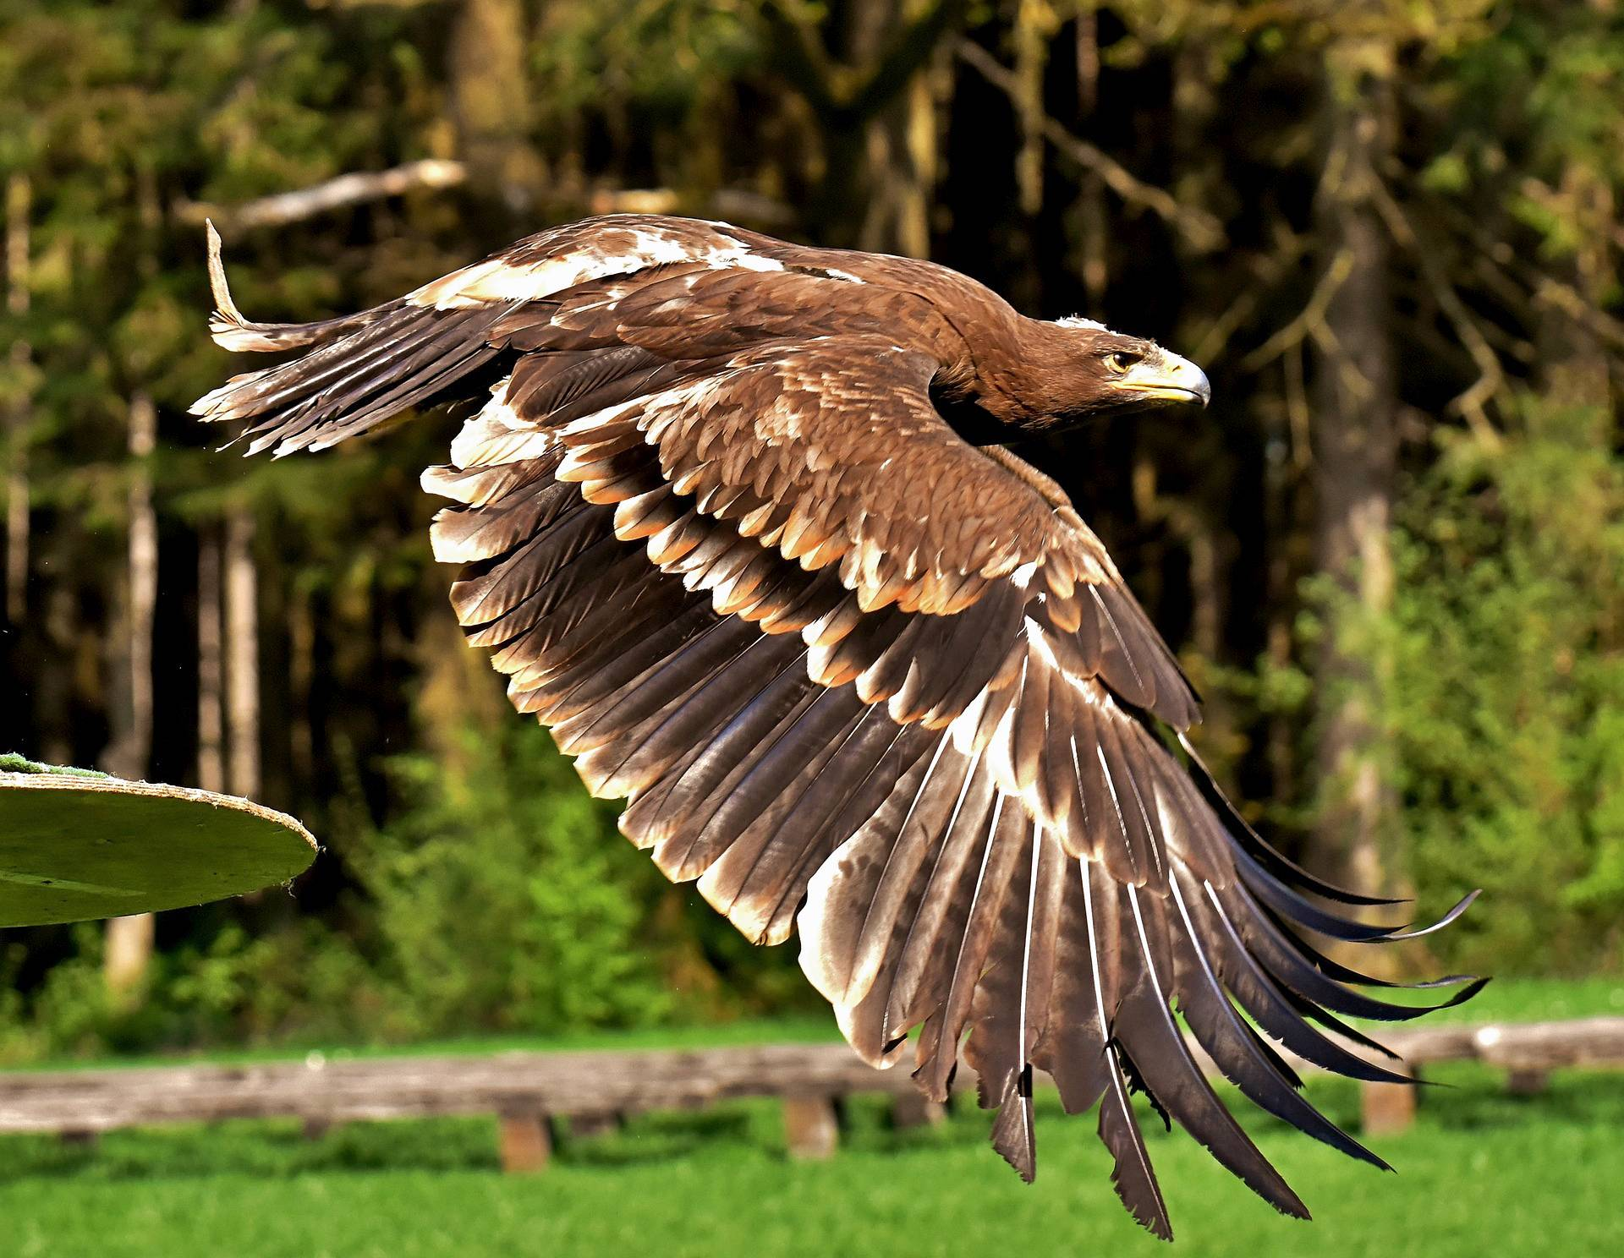
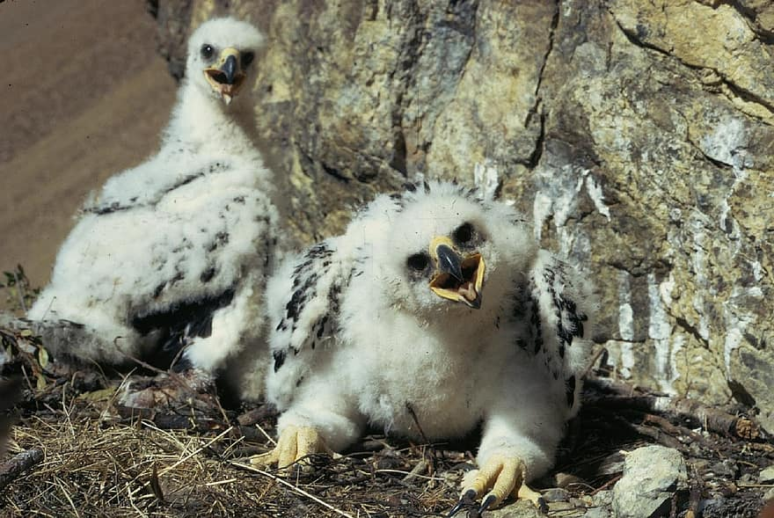
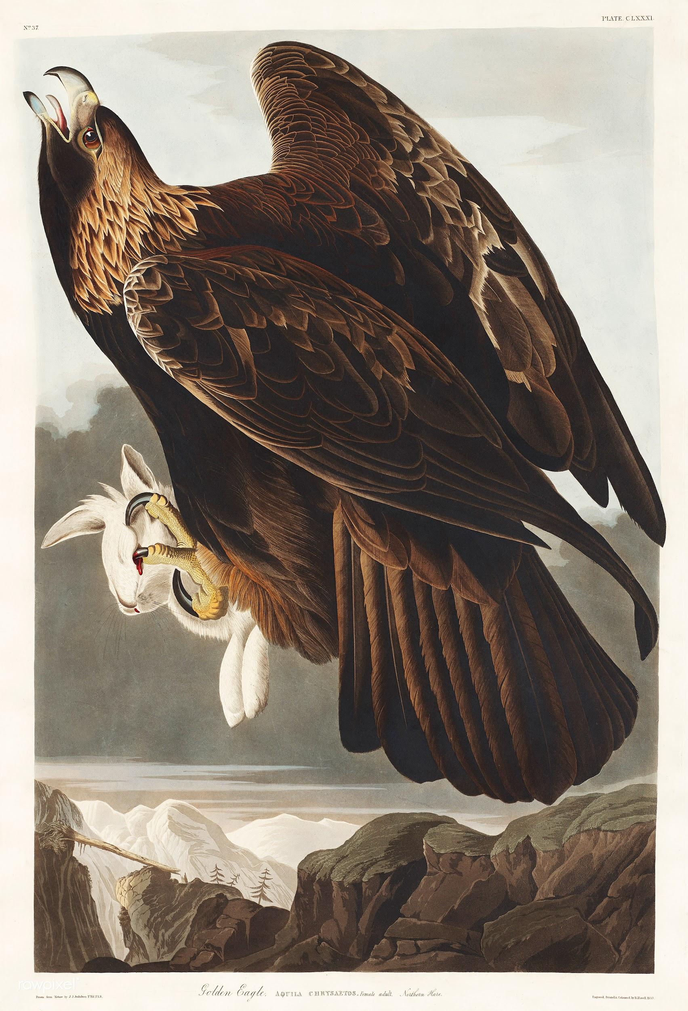
Tips and fascinating facts!
Don’t take this fast with your bird give him/her time to develop.
Make sure you know basic information about your bird: lifespan, weight, wingspan etc.
You wouldn’t want to be the person that doesn’t know ANYTHING interesting about your bird, right? Read on to find out intriguing tips and facts about your bird that will make you and your bird’s relationship stand out!
And adults are dark brown
Young have white patches in their wings.
A Golden Eagle's wingspan is the size of an average full grown man!

Slide 4
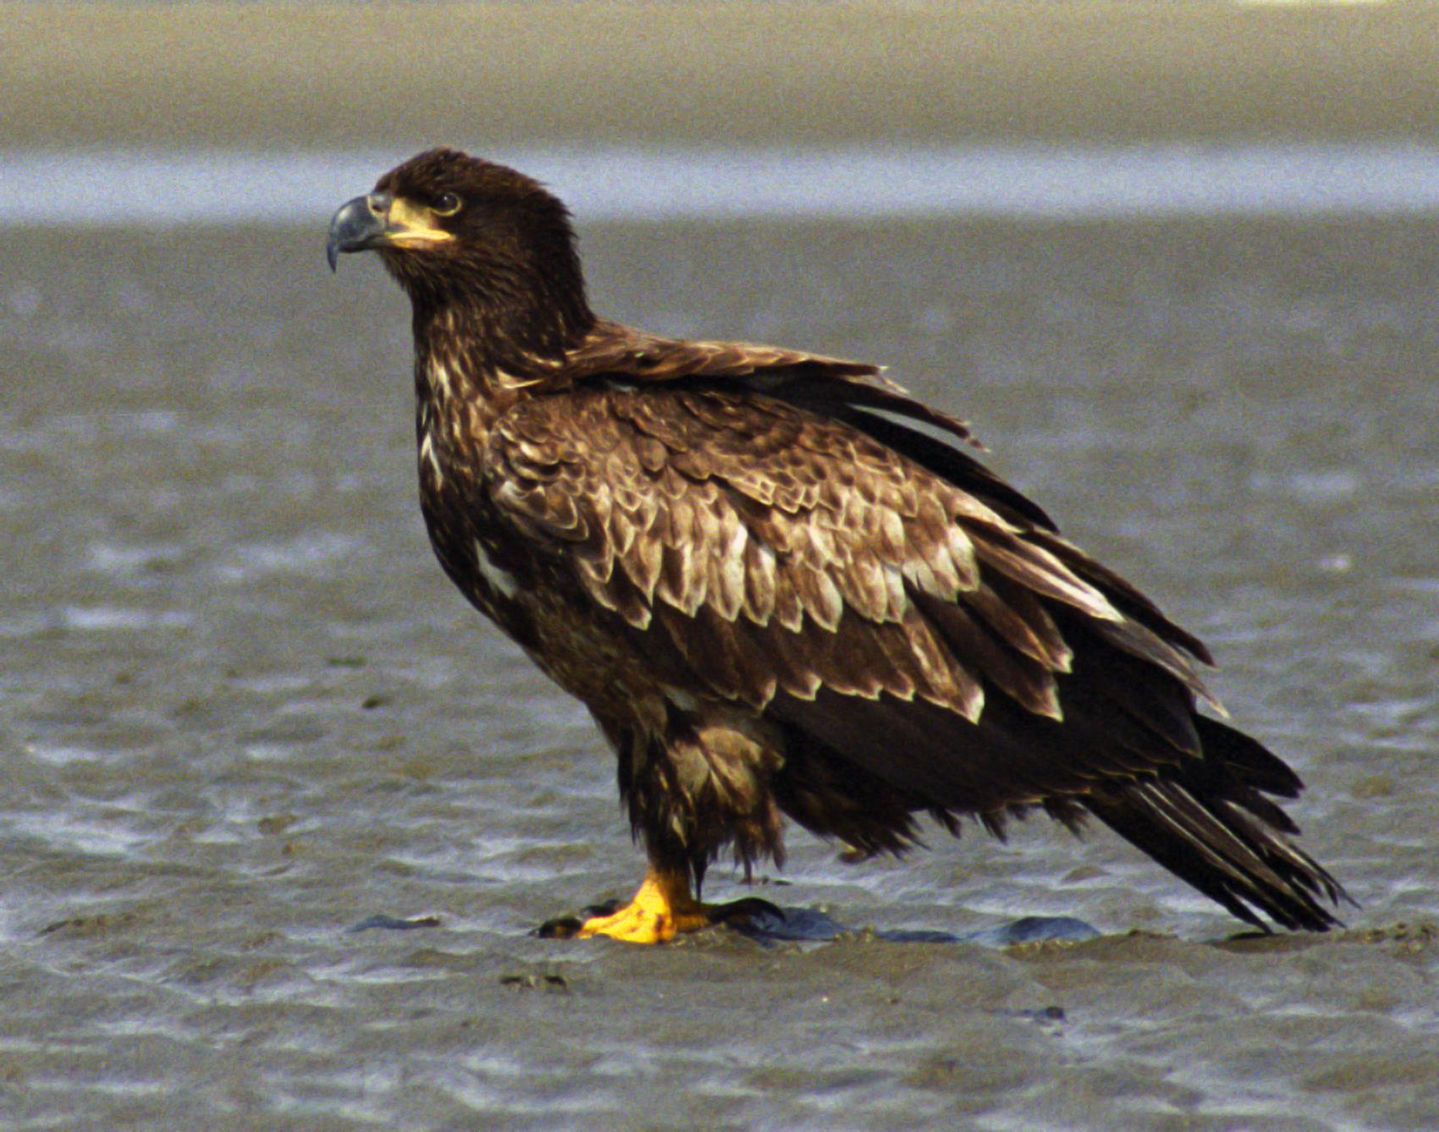
Glossary
Native- born in a specified place.
Vegetation- plants considered collectively, especially those found in a particular area or habitat.
Urban- in, relating to, or characteristic of a town or city.
"the urban population"
Agricultural- the science or practice of farming
Forested- covered with forest.
Carrion- the decaying flesh of dead animals.
Lure- tempt (a person or animal) to do something or to go somewhere, especially by offering some form of reward.

Slide 5
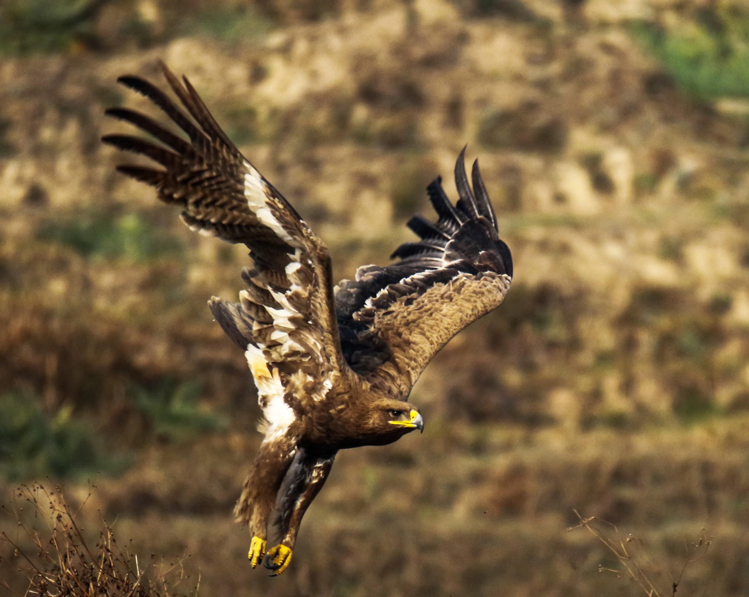
Conclusion
By the end of this your bird should be exploding with happiness. They should be healthy, fit and happy, and you should now know how to take care of your Golden eagle. I hope all those question you had walking around in your head about golden eagles have been answered. Are you now the best informed eagle-eyed expert to ever walk the earth? If you would like to know more, If your imagination wants to look more into the future, If you still have questions bursting to get asked and answered, then I would love to introduce you to the best website yet to answer all your questions full with adrenaline, a chance to know more about different species of birds. Visit https://www.britishbirdofpreycentre.co.uk/ for the best experience of your life. Thank you for taking your time to read this. I would love to here your input and satisfaction about my manual. A big thank you again and I would like to wish you a wonderful rest of your day.

